Slide 1
Detecting Market Manipulation: Forecasting Pump and Dump Schemes in Cryptocurrency
Presentation : III
Date : 2024/12/12
Ajeet Kumar Rai
Department of Applied Mathematics and Statistics, Stony Brook University
ajeetkumar.rai@stonybrook.edu

Slide 2
INTRODUCTION
The project aims to predict pump and dump events in cryptocurrency markets.
Manipulators artificially increase prices (pump) and then sell (dump), causing prices to fall.
The goal is to detect early signs of such manipulation to protect investors from potential losses.

Slide 3
RECAPITULATION
Below data was prepared by previous authors.
External data prepared using yahoo finance.
Features | Data Types
Date | object
Open | float64
High | float64
Low | float64
Close | float64
Adj Close | float64
Volume | float64
coin | object
Market_Cap | float64
Pct_Change | float64
Month_Year | object
PD | float64
isPenny | int64
drawdown | float64
drawdown_percentage | float64
Open_1m_avg | float64
Open_3m_avg | float64
Open_6m_avg | float64
Open_12m_avg | float64
Open_24m_avg | float64
Open_1m_std | float64
Open_3m_std | float64
Open_6m_std | float64
Open_12m_std | float64
Open_24m_std | float64
Open_1m_volatility | float64
Open_3m_volatility | float64
Open_6m_volatility | float64
Open_12m_volatility | float64
Open_24m_volatility | float64
channel_id | session_id | coin | exchange | pair | timestamp
1095533634 | 256 | APPC | binance | BTC | 2019-06-04 12:01:33+00:00
1095533634 | 258 | REQ | binance | BTC | 2019-06-08 13:00:02+00:00
1095533634 | 278 | ADX | binance | BTC | 2019-07-05 17:01:12+00:00
1095533634 | 285 | SNM | binance | BTC | 2019-08-07 16:59:48+00:00
1095533634 | 287 | DATA | binance | BTC | 2019-08-15 20:00:07+00:00
1095533634 | 293 | QSP | binance | BTC | 2019-08-29 18:00:05+00:00
1095533634 | 296 | DATA | binance | BTC | 2019-09-08 18:00:04+00:00
1095533634 | 299 | EDO | binance | BTC | 2019-09-23 12:59:59+00:00
Already Prepared Data
Yahoo Finance

Slide 4
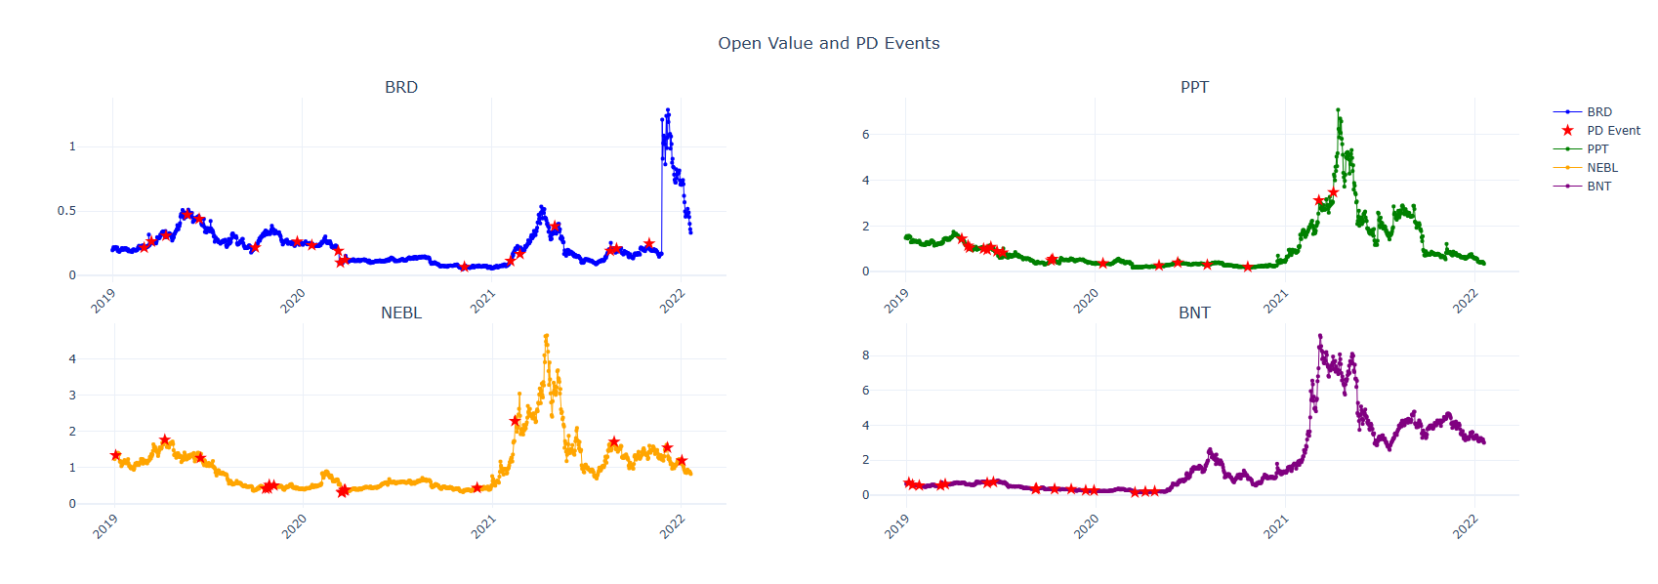
RECAPITULATION
PD events found with lower open price.

Slide 5
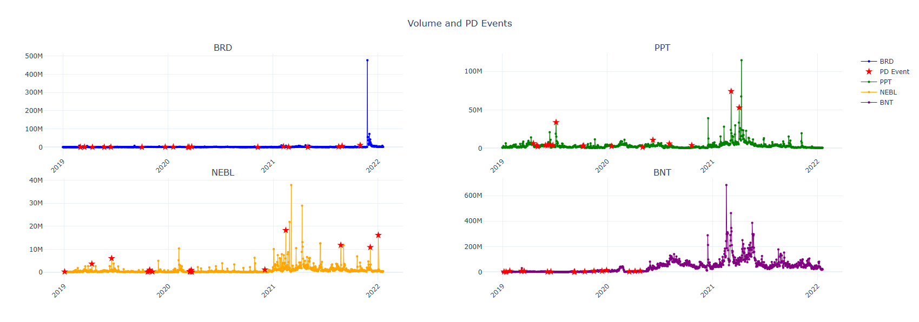
RECAPITULATION
Volume are low when PD occurred.

Slide 6
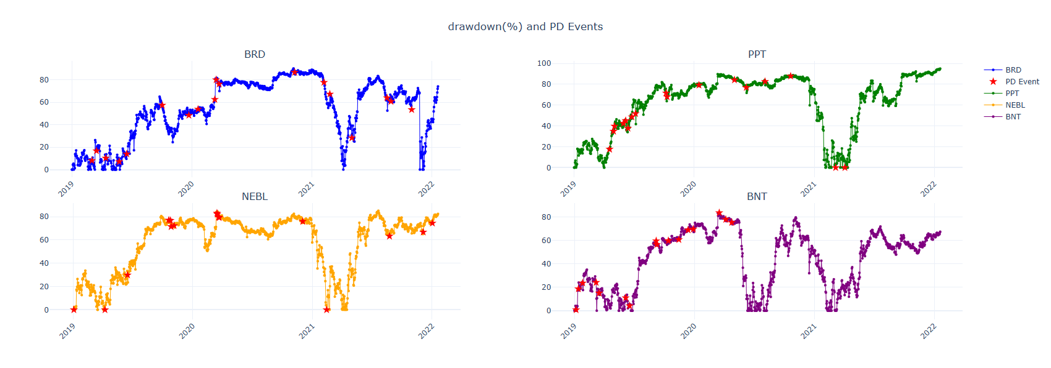
RECAPITULATION
Drawdown = Previous Peak- Current
Higher drawdown when PD occurred.

Slide 7
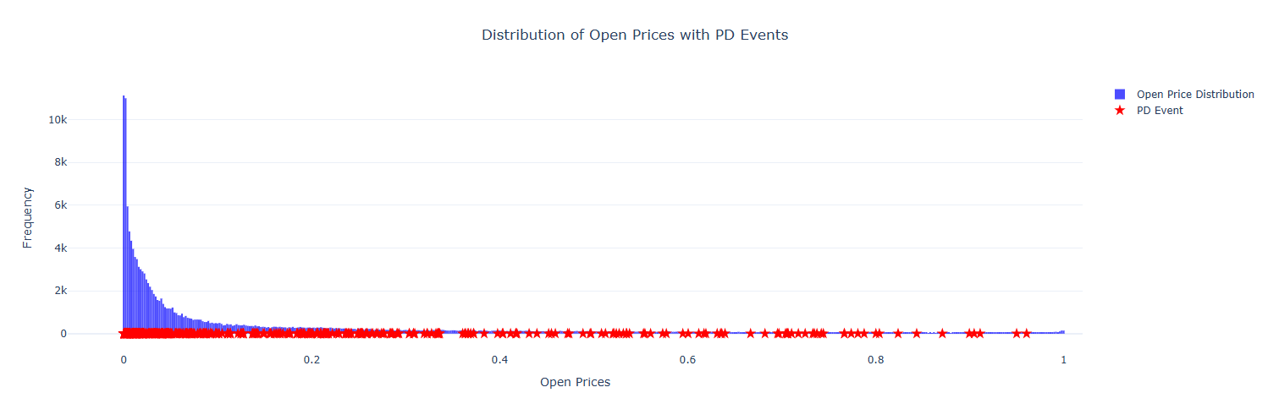
RECAPITULATION
Lower the open price more vulnerable to PD.

Slide 8
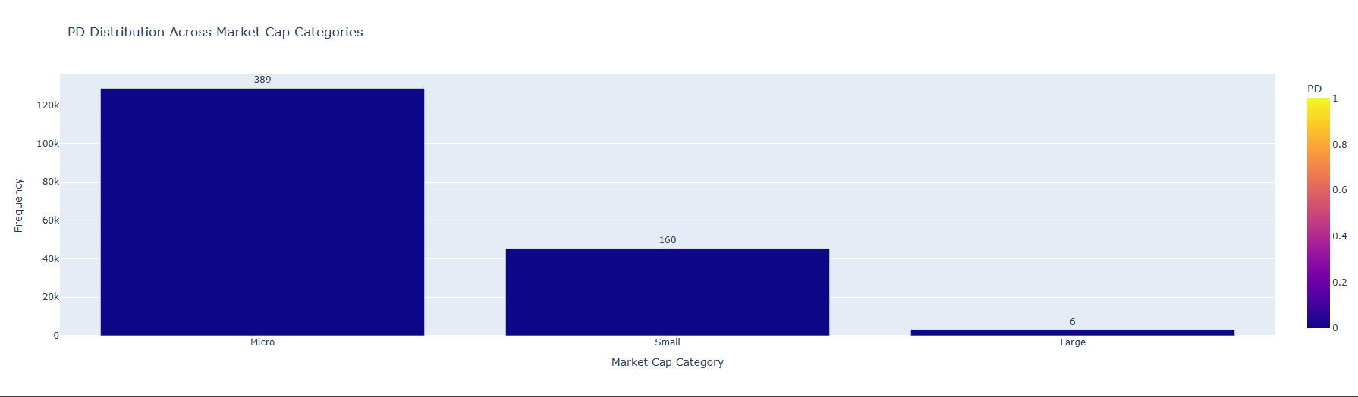
RECAPITULATION
Micro market category with most number of PD.

Slide 9
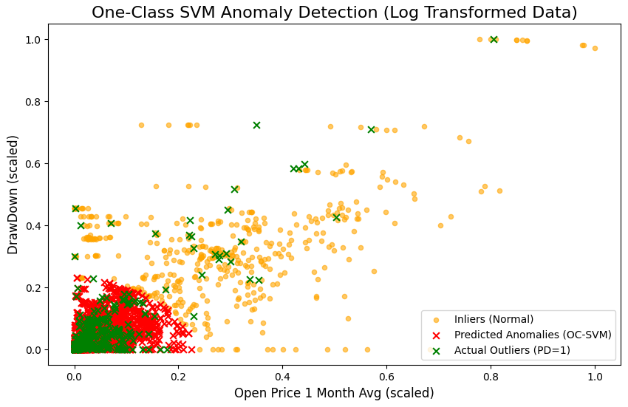
RECAPITULATION
With features drawdown and average of one month open price, OC - SVM classified most of the PD data points correctly.
Model can be improved with complete set of data points and features.
Conformal Prediction can help to reduce false positive cases.

Slide 10
DATA
Total observations : 182855
Total PD Events : 560 (0.3%)
Total features : 24
Missing values dropped.

Slide 11
SAMPLING
Balanced : Random Under Sampling
Data randomly under sampled by making the majority class equal to the minority class.
Causes a huge loss of information in the data.
Data is balanced, accuracy can be used as the evaluation metric.
Imbalanced : Sampling with outlier removal
Data less than 10 percentile and more than 80 percentiles were removed.
New data include 37,204 from the majority class and 560 from the minority class.
Data is not balanced, Precision, Recall, AUC can be used as the evaluation metric.

Slide 12
ML PIPELINE
80% of data used for training and 20% for testing.
Features with missing values have been dropped, and only one data point from the minority is excluded.
Log transformation has been used.
To avoid overfitting, Stratified –K fold implemented.
The parameters were optimized using grid search and manually.
Models
One-Class SVM
K-Nearest Neighbors
Random Forest
XGBoost
Neural Network
Ensemble model (KNN+RF+XG+NN).

Slide 13
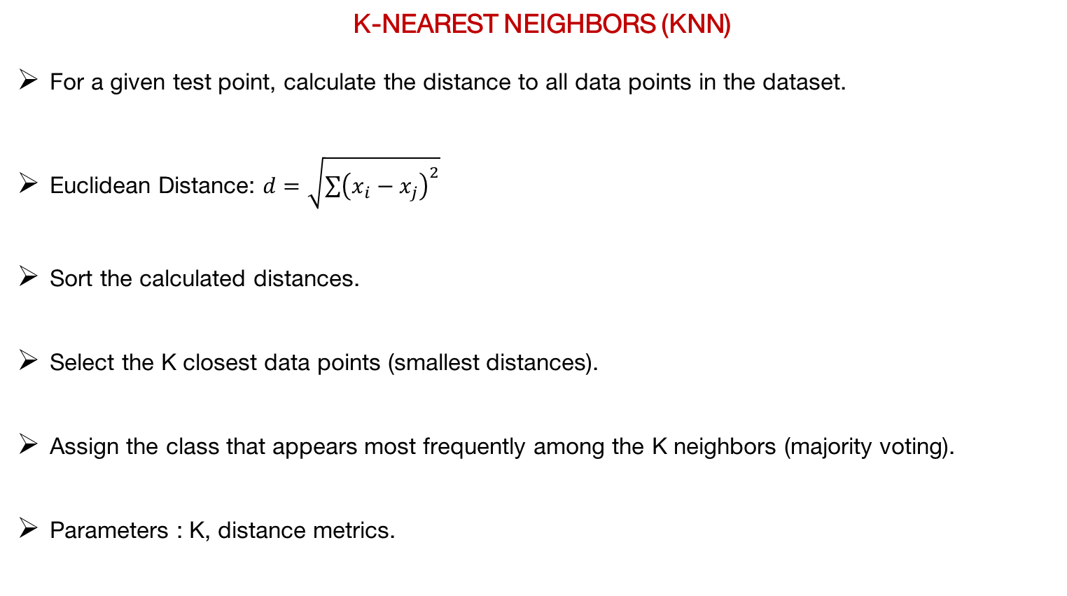
K-NEAREST NEIGHBORS (KNN)
For a given test point, calculate the distance to all data points in the dataset.
Euclidean Distance: $d=\sqrt{\sum{{\left(x_{i}−x_{j}\right)}^{2}}}$
Sort the calculated distances.
Select the K closest data points (smallest distances).
Assign the class that appears most frequently among the K neighbors (majority voting).
Parameters : K, distance metrics.

Slide 14
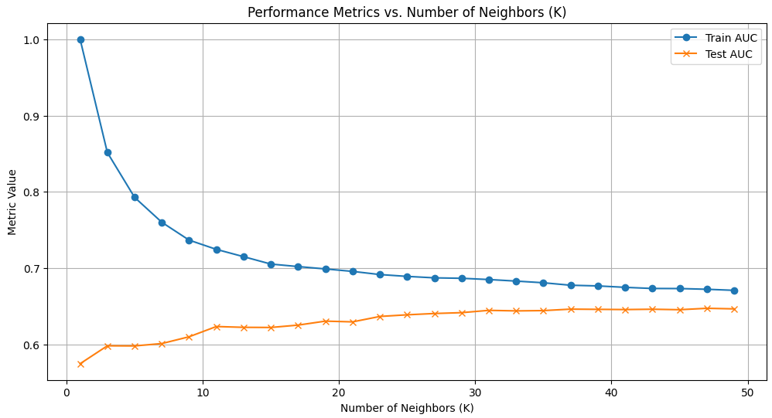
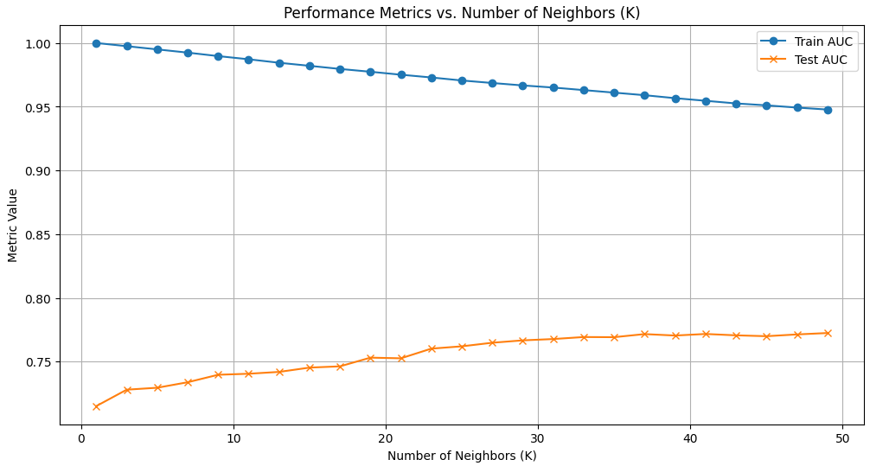
K-NEAREST NEIGHBORS (KNN)
Random Under Sampling : K=47
Outliers removal Sampling : K=49

Slide 15
BAGGING METHOD : RANDOM FOREST
Take 2/3 of data to build the tree and remaining data for out-of-bag error.
Bootstrapping: Repeat the above steps for multiple decision trees of the training data.
Optimize parameters such as number of tree, depth, number of features, etc.
Vote for one class in each tree.

Slide 16
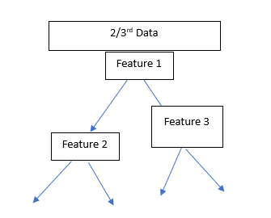
BAGGING METHOD : RANDOM FOREST
Vote

Slide 17
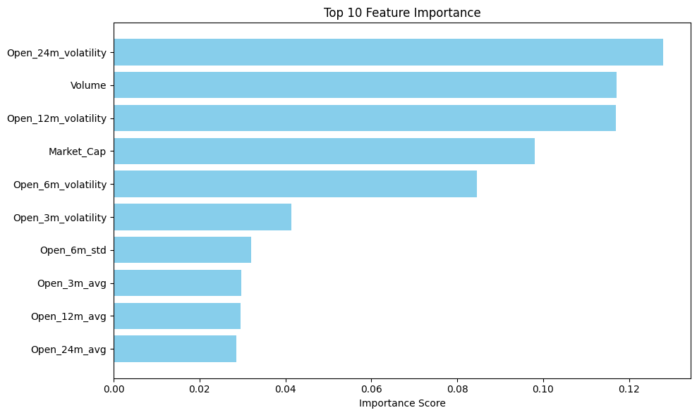
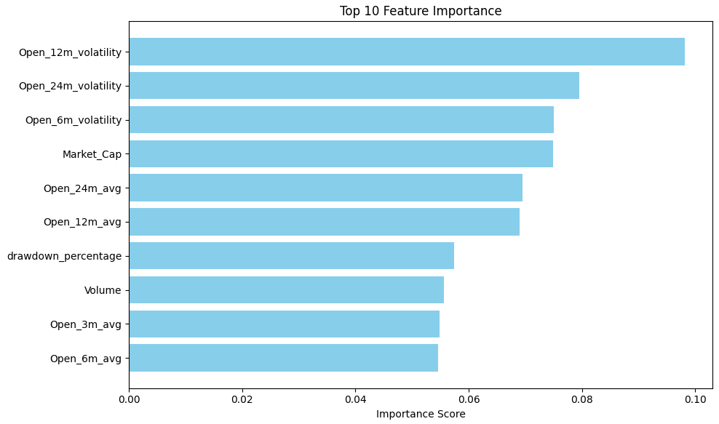
BAGGING METHOD : RANDOM FOREST
Number of trees=500, Maximum Depth=3, Minimum Sample for Split=7
Minimum sample at leaf=5, class weight=balanced
Vote for one class in each tree.

Slide 18
BOOSTING METHOD : XG BOOST
Weak learner 1 + Weak learner 2 +…..+ Weal Learner n.
Combines a loss function and a regularization term.
Trees are added sequentially, with each new tree improving on the errors of the existing ensemble by minimizing the loss function.
L1 (lasso) and L2 (ridge) regularization are applied to penalize large coefficient.

Slide 19
BOOSTING METHOD : XG BOOST
An initial model F₀ is defined to predict the target variable y, associated with a residual (y – F₀).
A new model h₁ is fit to the residuals from the previous step
Now, F₀ and h₁ are combined to give F₁, the boosted version of F₀.
F₁(x)<-F₀(x)+h₁(x)
F_{m}(x)<-F_{m-1}(x)+h_{m}(x)

Slide 20
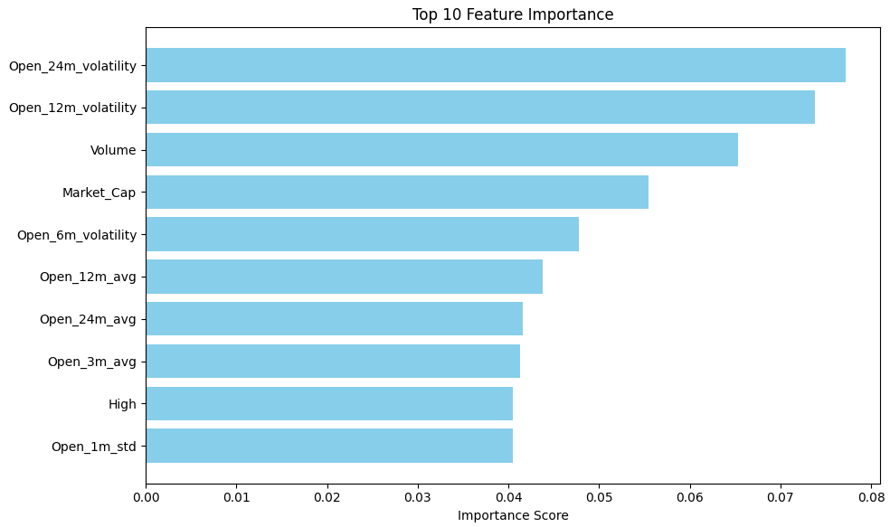
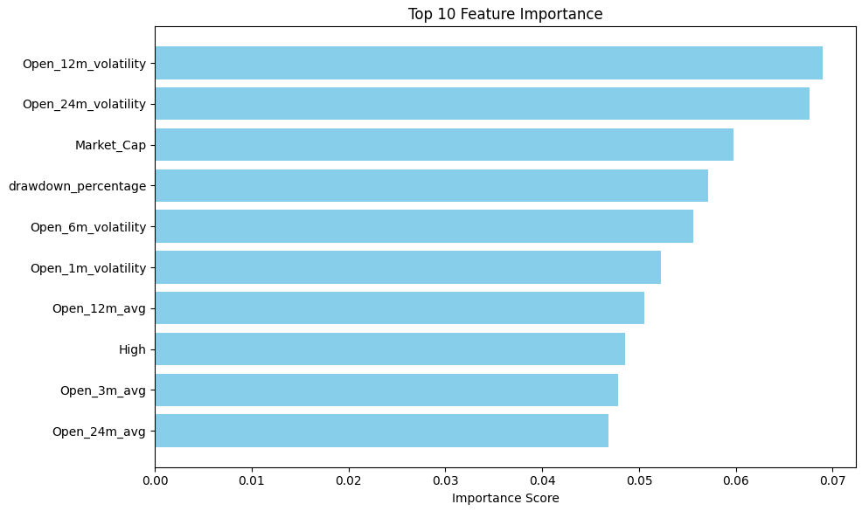
BOOSTING METHOD : XG BOOST
Number of trees=500, Maximum Depth=3, Learning Rate=0.001
Minimum Child Weight=3, Subsample=0.3,Evaluation Metric=AUC

Slide 21
NEURAL NETWORK
Neural networks consist of layers of nodes (neurons), including an input layer, one or more hidden layers, and an output layer.
Each neuron in a layer is connected to neurons in the next layer through weights.
Each neuron processes the input data using a weighted sum and applies an activation function (e.g., ReLU, sigmoid) to introduce non-linearity.
Forward propagation: It compares the actual and predicted values ​​and calculates the loss.
Back propagation: It updates the gradient based on the calculated loss.
Terminates when the loss function is minimized or the set parameters are achieved.

Slide 22
NEURAL NETWORK
Library used : Sklearn MLP
Parameters
Hidden layer sizes is 32, 64, and 32.
Activation Function =tanh
Solver=Adam
Alpha=0.0001

Slide 23
ENSEMBLE LEARNING
Ensemble learning combines predictions from multiple models to produce a more robust and accurate final prediction.
Types: Bagging, Boosting, Stacking, Voting etc.
The diversity of individual models helps reduce errors, as different models compensate for each other's weaknesses.
Voting : RF + XGB + KNN + MLP

Slide 24
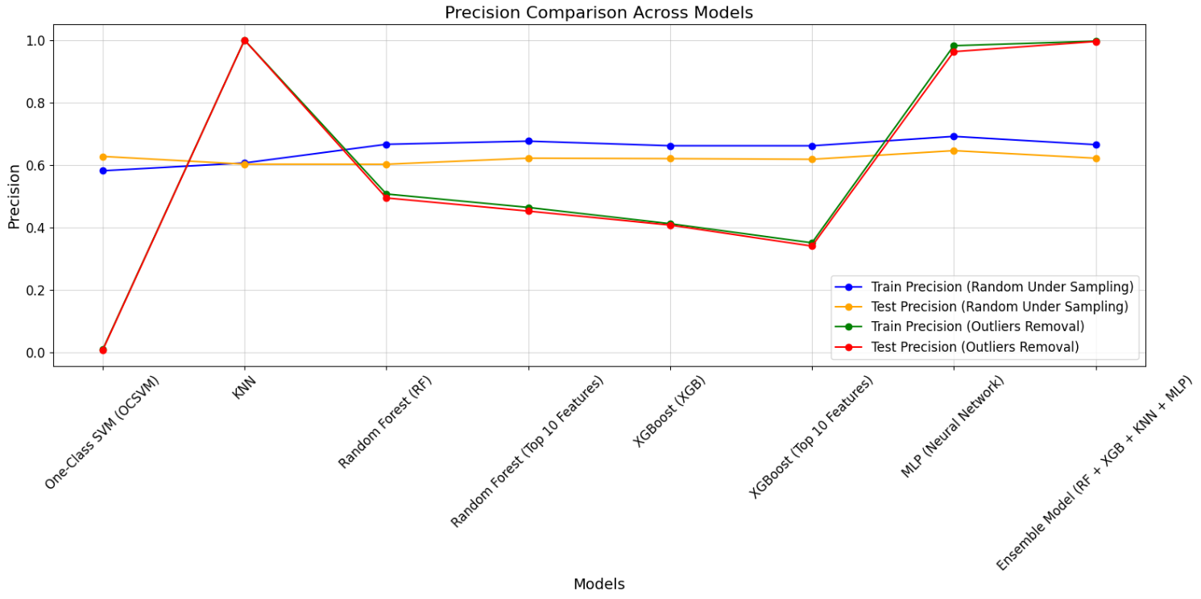
RESULTS - PRECISION
True Positives : Correctly predicted positive instances.
False Positives: Incorrectly predicted as positive.
Precision=TP/(TP+FP)

Slide 25
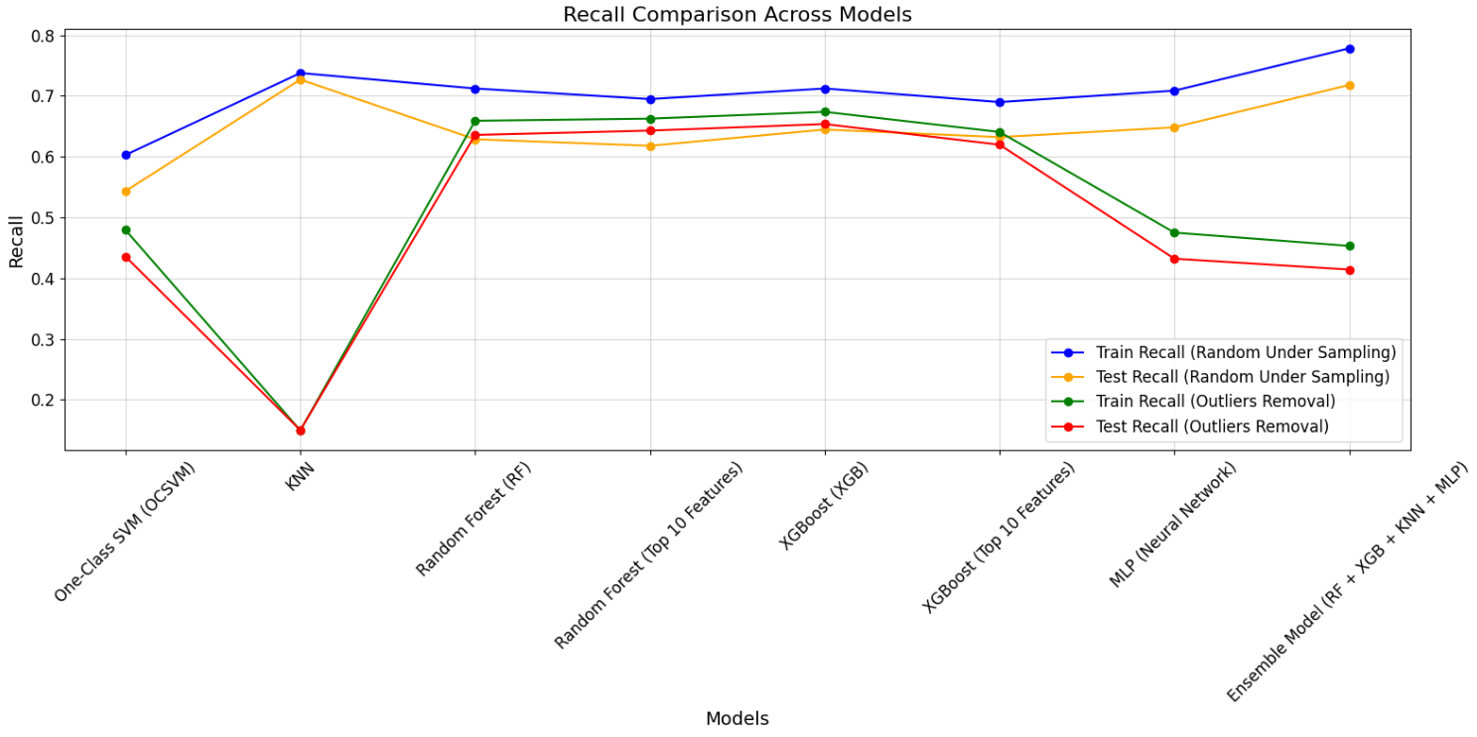
RESULTS - RECALL
False Negatives: Actual positive incorrectly predicted as negative.
True Positives : Correctly predicted positive instances.
Recall=TP/(TP+FN)

Slide 26
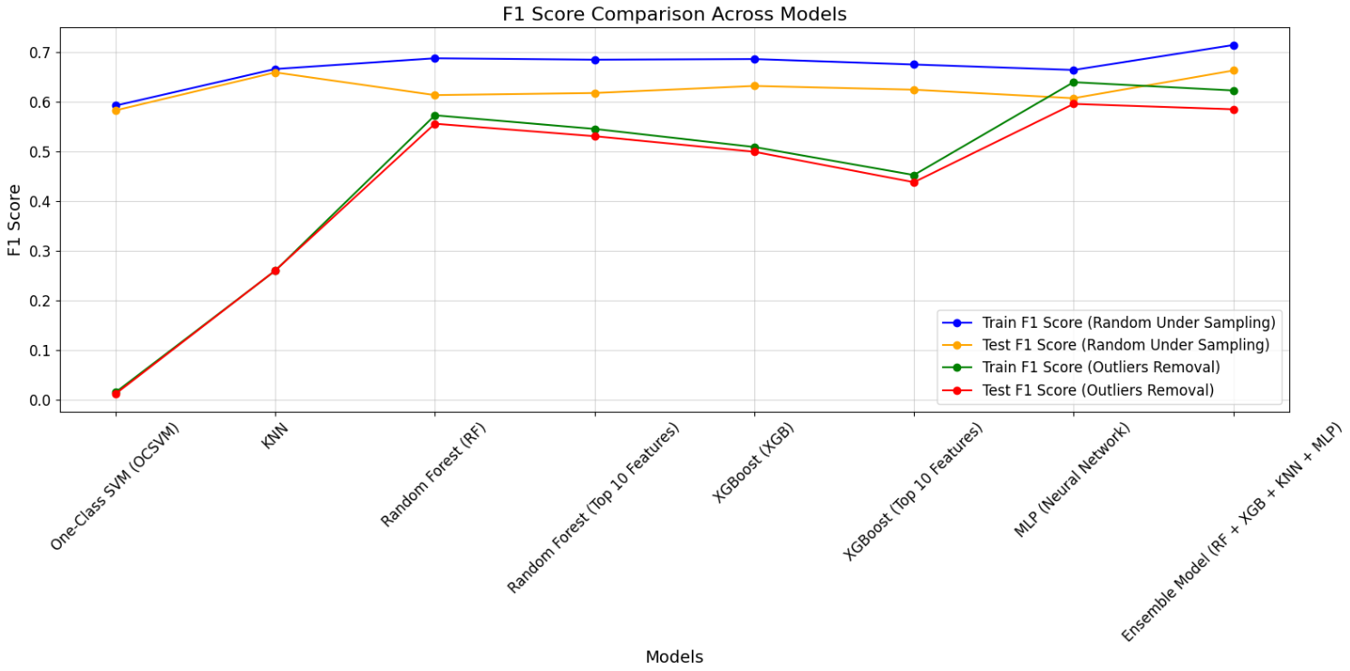
RESULTS – F1
F1 =2* Precision* Recall/(Precision+ Recall)

Slide 27
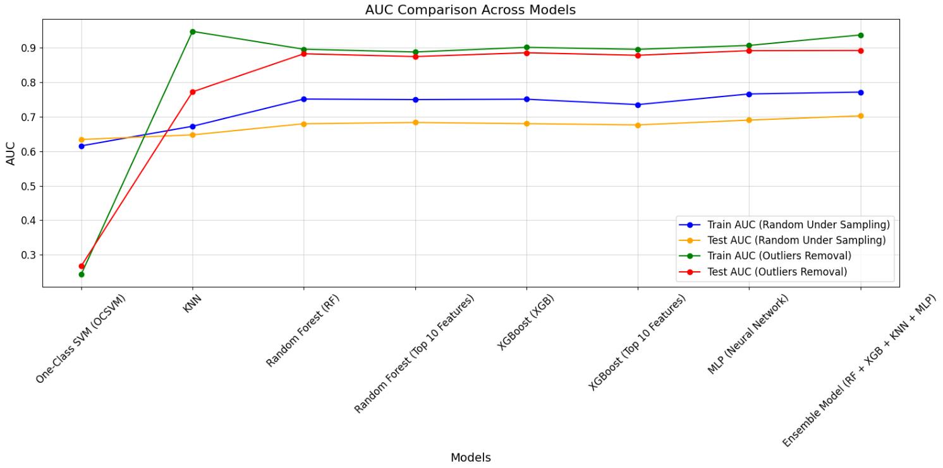
RESULTS - AUC
Recall/Sensitivity/TPR = TP/(TP+FN)
FPR = FP/(FP+TN)
The ROC-AUC curve plots the recall against the False Positive Rate for various thresholds.

Slide 28
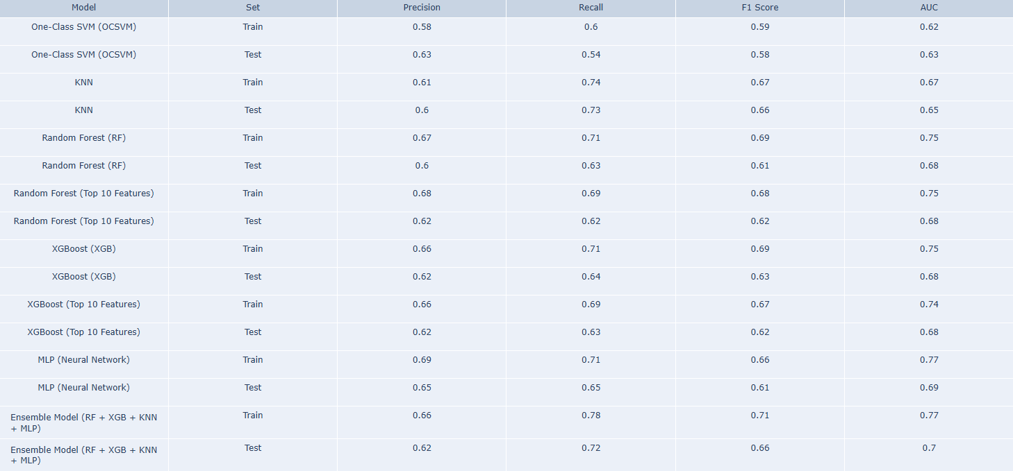
RESULTS
Balanced data : Ensemble Model outperforms the other in terms of AUC.

Slide 29
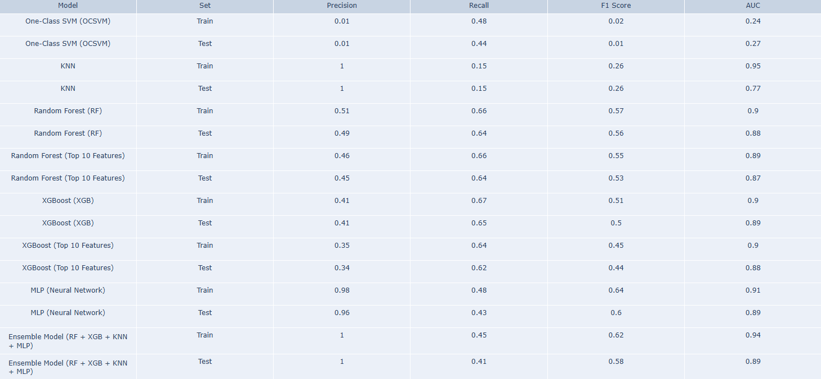
RESULTS
Imbalanced data: RF, XGB and Ensemble Model outperforms the other in terms of AUC.

Slide 30
CONCLUSION
KNN and Ensemble Models perform well on both training and test sets for Random Under Sampling, with high precision but lower recall on test data.
One-Class SVM (OCSVM) shows low performance on both Train and Test sets across all metrics for Outliers Removal, especially in recall and precision.
XGBoost and Random Forest models, particularly with Top 10 Features, show competitive results in terms of AUC for both datasets, with a notable drop in performance on test data.
MLP (Neural Network) consistently performs well on Random Under Sampling, with higher AUC and accuracy compared to Outliers Removal.
Ensemble Model demonstrates the best performance in Random Under Sampling, with a high F1 score and AUC, outperforming individual models on the test set.

Slide 31
REFERENCES
https://www.analyticsvidhya.com/articles/knn-algorithm/
https://www.geeksforgeeks.org/xgboost/
https://www.geeksforgeeks.org/random-forest-algorithm-in-machine-learning/
https://en.wikipedia.org/wiki/Neural_network#:~:text=A%20neural%20network%20is%20a,network%20can%20perform%20complex%20tasks.
https://www.geeksforgeeks.org/understanding-one-class-support-vector-machines/
https://scikitlearn.org/stable/modules/generated/sklearn.model_selection.StratifiedKFold.html
https://en.wikipedia.org/wiki/Ensemble_learning

Slide 32
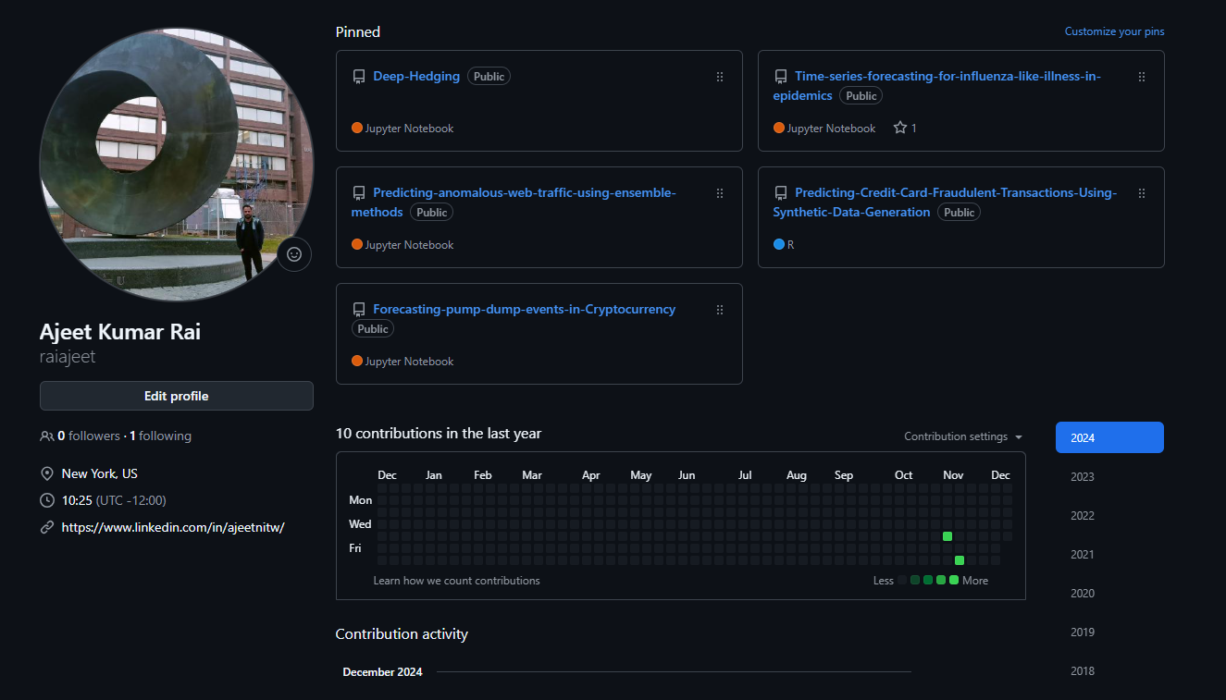
GITHUB
https://github.com/raiajeet/Forecasting-pump-dump-events-in-Cryptocurrency

Slide 33
THANK YOU !

